Slide 1
How to find information at Masters level, and use it right
Jennifer Rowland
Faculty Librarian
j.rowland2@bradford.ac.uk
Book an appointment: https://bradford.libcal.com/appointments/jrowland

Slide 2
Session overview
Finding reliable sources for your assignments:
Before you start- creating a search
Where to search
www.bradford.ac.uk/library (Summon)
Scopus
British Standards Online
Search tips
What is written coursework for?
Reminder about plagiarism and referencing
Sources of help

Slide 3
Books to help with your studies and dissertation
We have books about study skills, managing a project, doing your literature review, making sense of the research you read, doing your research, interpreting your results, and writing a dissertation.
Search in the Summon search box in the middle of the page at http://www.bradford.ac.uk/library/

Slide 4
Using reliable sources
This is an academic course, not just practical training
You need to read reliable sources and discuss what you learn from them and how it influences your decisions
Textbooks give the theoretical background but for communicating new research, the gold standard of good evidence is journal articles

Slide 5
Using reliable sources
This session is about finding journal articles, conference papers, and standards
These are key sources for up-to-date information in the field (along with technical papers)
They are usually available to you because the library has paid a subscription for them.
On-campus we use IP authentication to get to the full text, off-campus you will need your username and password

Slide 6
Before you start
Know what your question is
Pick out the key words
Think of other words that might be used for the same ideas
Check you have thought of all the concepts around your question
Know where to look
Project: A relational database- data entry will be by admin staff so it needs a user-friendly front end

Slide 7
A user-friendly front end for a relational database
Key words: user-friendly, front end, relational database
Other words: user experience, UX; human-computer interface/human-computer interaction, HCI; interaction design; usability; user interface
Other concepts, eg
Legal duty for design to be accessible
Natural language entry?; controlled vocabulary?; graphical UI; other constraints (input only or query?)
Web-based or local database
Language of database
Where to look: Summon/Scopus/British Standards Online
www.bradford.ac.uk/library

Slide 8
Session overview
Finding reliable sources for your dissertation:
Before you start- creating a search
Where to search
www.bradford.ac.uk/library (Summon)
Scopus
British Standards Online
Search tips
What is the FYP for?
Reminder about referencing
Sources of help

Slide 9
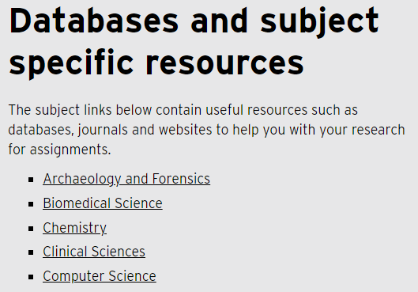
Go to the library homepage bradford.ac.uk/library -Click on the “Library resources” tab -Click through to Databases and subject specific resources, then on “Computer Science”
Search reminders and tips

Slide 10
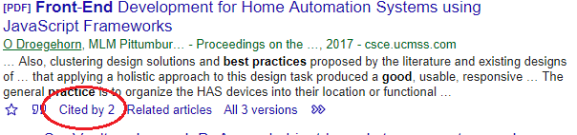
Search reminders and tips
Be ready to change your search words when you see your results
Narrow your search with headings in the left sidebar
Look at “Cited by” in Google Scholar for more recent papers

Slide 11
Search reminders and tips
‘*’ wildcard - education* to search for education, educational, educationalist…
Click the 360 Link button to find if we have a link to it
Tick boxes to mark records to save or email to yourself
Ask your supervisor if there are particularly useful journals for your topic
Creating an efficient search is a transferable skill, part of digital literacy, and it’s useful for employability
- practice thinking of keywords and using AND/OR in Google.

Slide 12
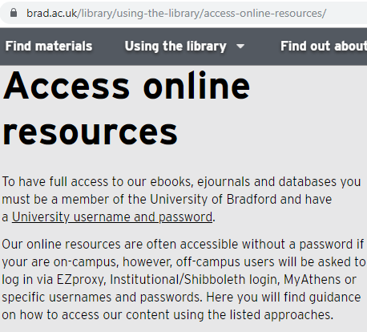
Off Campus?
Yes
Follow links from Summon to get correct login links
UOB username and password
See Library webpage
https://www.bradford.ac.uk/library/library-resources/access-online-resources/

Slide 13
Session overview
Finding reliable sources for your dissertation:
Before you start- creating a search
Where to search
www.bradford.ac.uk/library (Summon)
Scopus
British Standards Online
Search tips
What is written coursework for?
Reminder about referencing
Sources of help

Slide 14
The point of doing coursework
To learn something and evidence that to the lecturers. – You need to spend part of the module's directed study time reading until you understand your topic – and then spend time writing to demonstrate what you know and how you have met the module learning outcomes.
To practise research and writing for your dissertation
Everything in your projects must be your own work
(Except when you are telling your reader about what you read, and then you will cite and reference to show where your knowledge came from)
If you plagairise, you don't learn.

Slide 15
Plagiarism and ethics
Plagairising is not fair to the students who do their own work. • It is not fair to employers- they deserve to know that a Bradford graduate has really learnt everything they need to know, not just copied from other people. • It is not fair to the University- it devalues a Bradford degree if people see that our graduates do not know what they should. • It is not fair to the people who actually created the source that a plagiariser uses- they deserve to get the credit for their hard work. • It is cheating!

Slide 16
What does "your own work" mean?
You, yourself, need to understand the topic, think of what to write, and then write it.
Your work needs to be written in your own words, your own "voice". It needs to show off what you know.
Think of it as explaining to someone what you learned from doing the reading for the assignment.
Start your notes for the assignment in a blank document, and write sentences yourself that talk about what you learned.
Cite and reference in your work to show the sources of your information.

Slide 17
Being investigated for plagiarism
If the person marking a piece of work thinks it might be plagairised, and sends it to be investigated:
The investigation will take at least 3 months. Therefore everything gets delayed by 3 months or more.
There are heavy marks penalties.
Be very careful!
The university uses Turnitin, but you can be investigated even with a low percentage score if the marker is suspicious.
Understanding your Turnitin draft report (presentation)

Slide 18
You must write your own project
Getting an AI program to write your work for you is cheating- it is plagiarism and deceit.
Doing this would mean you wouldn’t learn anything. Submitting what something spits out at you is not doing your own work!

Slide 19
Am I allowed to use AI: The academic context
When you graduate, you should be able to demonstrate the skills and knowledge outlined in your programme specification
You will not achieve these if you use AI-generated work
Don't cheat yourself!
Your work must be your own, and in your own words
You will graduate with a degree taught in English, which will be taken by employers to mean that you are fluent
If you have used paraphrasing tools to re-write your work, you have not demonstrated fluency.
You mustn't use AI tools to help write your work unless your lecturers say that it's OK for a specific assignment.

Slide 20
Unethical uses of AI in writing
If you got a person to do something for you, would it be cheating? Then it's probably cheating if an AI does it, too.
If you don't know whether a tool is AI, assume that it is. For example, Quillbot and the writing suggestions of Grammarly are both unacceptable AI tools.
Using AI is misconduct if:
The work you submit is not fully your own
The work you submit is not in your own words
Your reference list does not openly and honestly reflect your reading
Your citations attribute information to a source that does not contain it
Your reference list contains sources that do not exist

Slide 21
Other issues with AI
Many of the AI tools have no regard for the security or privacy of any data you put in to them
The data to train AI tools came from the internet. Therefore it can produce work that reinforces existing prejudices
For instance, this story on AI-generated Barbies of the World
They were trained on people's data without their consent

Slide 22
An AI cannot give you just the true facts about a topic
It can be tempting to use AI to give you a summary of a subject but this is a terrible idea.
You will always need to spend as much time checking everything it wrote as you would have spent doing it yourself to begin with.
Do subject experts use AI tools? Yes, sometimes, but they have a knowledge base that helps them fact-check. You don't have that yet.
AIs are trained on huge batches of text from the internet
But they are trained to write real-sounding sentences, not to know real facts.
Plus they are known to "hallucinate"- to make things up. These will sound convincing and will be mixed in with facts, so you will end up with a false picture of the subject.
Experts in AI have been telling us this since the chatbot boom began.
If you try to use an AI as if is was a search engine (to try to find primary sources that you can read), or you try to use it like Wikipedia (to try to give you a quick overview and give you links):
It makes up the citations as well as the facts.

Slide 23
Critical skills
You need to develop your critical analysis skills along with your subject knowledge
Always check: how do I know this is true? What might be wrong with it? Who created it, and why?

Slide 24
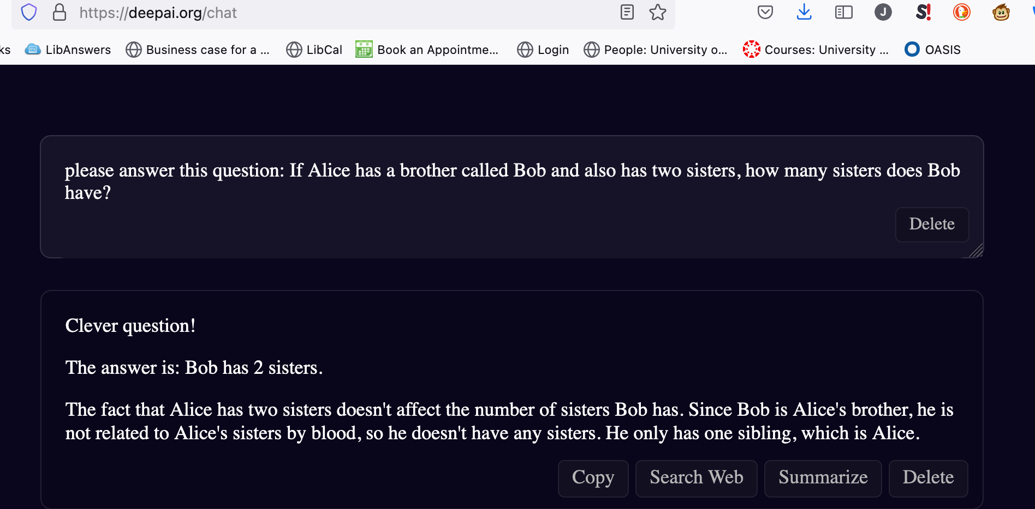

Slide 25
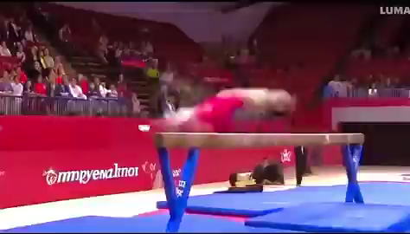
Deedydas (2024) Gymnastics is the Turning test of video generation models https://x.com/deedydas/status/1808188513512575179?mx=2 x.com Accessed 29 August 2024​

Slide 26
More examples of AI getting things wrong
Getting 83% of medical questions wrong
Deadly meal suggestions
Primes ending in 2
Poisonous plants
Lying about octopuses
Fake figures
Becoming completely incoherent
Writing less secure code
ESL aspects
Insight into why it makes some errors: it assumes that every question about a fact is about the most common version of the question
Some image things that give clues about how much it "bluffs"
Horrifying baseball video

Slide 27
How to do your project without AI
To find a quick overview of your topic:
Use Summon to find a textbook- they have been written by experts specifically to teach you!
To find research on a subject:
Use Summon and relevant databases to search for journal articles
Ask your subject librarian to help you search more effectively
To read and understand the research you find, and write the FYP:
Academic Skills have resources, workshops and one to one help with academic reading, critical analysis, notetaking, pulling information together, and writing
The Language Centre have resources and one to one help with English language skills
Your lecturers have office hours where you can ask about the subject area

Slide 28
Further information and help about using AI
There is more overview information as part of the Academic Integrity Induction (this is new since you did the Indiction in first year)
Talk to your module leaders! They are the ones who can tell you about what is expected and allowed in particular modules.

Slide 29
Session overview
Finding reliable sources for your dissertation:
Before you start- creating a search
Where to search
www.bradford.ac.uk/library (Summon)
Scopus
British Standards Online
Search tips
What is the FYP for?
Reminder about referencing
Sources of help

Slide 30
Citation and referencing in academic work
When you produce written work, you need to tell us about all the books, websites, journal articles (or anything else) where you learned things that went into your work.
This is a core part of academic writing in the UK.
You should reference:
Facts
Ideas
Quotations
Statistics, images, charts,
Anything that you did not create.
You need to take notes that include this information!

Slide 31
Why Reference?
Prevents you being accused of plagiarism
Acknowledges where you have used other people's work
Allows others to check and build on your work
To support your ideas, theories and add credibility.
Gains you extra marks!

Slide 32
Rules about quoting
Always better to paraphrase: only use direct quotations when they are making a specific point (if they are giving exact numbers you may need to quote)
Always use “quotation marks”
You must acknowledge a quote whether or not you can identify the author
Images, charts, tables etc are also someone’s work
Every quotation needs a citation

Slide 33
What is paraphrasing?
Putting what you read into your own words- rewriting it completely.
This shows you understand what you have read!
It also means that you can just pick out the key bits that are important to your work
You still need to tell us where you learnt the information.
A paraphrase from a book is still information form that book, you don't "own" it.
You may not use AI to paraphrase for you. Being able to rewrite is a skill that you need to learn.

Slide 34
Hints for easy paraphrasing
You aren’t writing a summary sentence-by-sentence- you’re pulling out the basic meaning, and any details that support it.​
Imagine you're explaining what you learned to a friend
What is your source talking about?​
Why have you decided to take this note- what do you care about in this source? Make sure that’s in your paraphrase. ​
Don’t start by copying a sentence and changing it!

Slide 35
Hints for easy paraphrasing
You aren’t writing a summary sentence-by-sentence- you’re pulling out the basic meaning, and any details that support it.​
Imagine you're explaining what you learned to a friend
What is your source talking about?​
Why have you decided to take this note- what do you care about in this source? Make sure that’s in your paraphrase. ​
Don’t start by copying a sentence and changing it!

Slide 36
Hints for easy paraphrasing
Read the source, then look away from it and write an explanation of what it means in your notes from your memory.​
Then look back at the source to make sure you haven’t misrepresented what it says
Write your assignment from your notes that are already paraphrased.

Slide 37
Have a look at some paraphrases and see if you think they are good or not
Click on the link in the chat to a Microsoft Form
Log in- you need this version of your username: jrblogg3@bradford.ac.uk
Answer the questions.

Slide 38
The original quote from a textbook says this. How good are each of the four paraphrases in the form?
"Approximately 4000 chemical compounds have been identified in cigarette smoke, of which over 40 are known to cause cancer. There are three important components of cigarette smoke. Their differing actions will be discussed below.
"▪ Nicotine. "▪ Tar. "▪ Carbon monoxide." (The textbook is Manual of smoking cessation by McEwan et al., 2006)

Slide 39
How to reference
Place a citation in the text next to the work you need to acknowledge
Remember, this can be ideas, facts etc not just words
The citation is the family name of the author followed by the year of publication (Carruthers 2019)
The citation points to the reference list at the end of your project.
The reference contains the full details of the source
The reference list is arranged in alphabetical order by the author’s family name

Slide 40
A book reference
Author(s) -
(family name first)
(Year of
Publication)
Book title
Ashby, M. F. (2013) Materials and the environment: eco-informed material choice. 2nd edition. Butterworth Heinemann.
Name of publisher
Edition (if not first)
If a book does not mention which edition it is, that means it is a first edition and does not need the edition statement
In-text citation
Ashby (2013) explains that….

Slide 41
Example of a journal article reference (Kara and Wrede 2022)
(Year of
Publication)
Article title
Author(s) -
(family name first)
Kara, H. and Wrede, S. (2022) Love’s labour’s lost? Separation as a constraint on displays of transnational daughterhood. Sociology 56(3), 522-537.
Page numbers
Journal title
Volume
Issue

Slide 42
Example of a website reference (Howard League for Penal Reform 2019)
Institutional
Author
(Year of
Publication)
Source title
Howard League for Penal Reform (2019) Prison watch.
https://howardleague.org/prisons-information/prison-watch/ Accessed 14 October 2022.
Web address
Date accessed

Slide 43
An example of part of a reference list
British Computer Society (2014). IT user qualifications. http://www.bcs.org/category/14405 (Accessed: 22 July 2014).
OECD, The. (2003) Cities: not as bad as we all thought. OECD, New York.
Ritchie, M. (2002) Be a local hero: strengthening our communities, health and environment by eating local. In Schor, J. and Taylor, B. (editors) Sustainable planet. Boston: Beacon Press.
Smith, J. (2001) What can we do about Bradford? City regeneration 45(10), 999-1004.
Xu, M., Khan, P. and Robinson, F. (2007) It takes a village to save a world. Sustainability quarterly 17(2) 156-79.

Slide 44
Help with citing and referencing
https://www.bradford.ac.uk/library/help/referencing-and-plagiarism/
https://bradford.instructure.com/courses/9626/pages/good-academic-pratice-for-final-year-projects?module_item_id=109497
There are online generators that can help you:
Bibcitation, Mybib or Zoterobib have our style, University of Bradford Harvard.
Don't use citethisforme!

Slide 45
Session overview
Finding reliable sources for your dissertation:
Before you start- creating a search
Where to search
www.bradford.ac.uk/library (Summon)
British Standards Online
Search tips
What is written coursework for?
Reminder about referencing
Sources of help

Slide 46
Can we help?
Email me j.rowland2@bradford.ac.uk (or englib@lists.bradford.ac.uk)
Book an appointment
https://bradford.libcal.com/appointments
“Need help” chat service and FAQs on the library page www.bradford.ac.uk/library
We have books about general study skills, study skills for students with particular needs like dyslexia or ESL, making sense of the research you read, academic writing, and more.
Study skills support:
Academic Skills Advice
Language Centre

